Slide 1
Building Brighter Futures Board of Education Facilities Update
April 11, 2026
Team:
Matthew Moss, Aaron Creel, Rachel Mikolajczyk, David Riley, Melissa Skelly, and Karen Thompson

Slide 2


For Today’s Discussion
As CMSD plans for implementation of the BBF recommendations, we are tackling some key facilities questions:
What is of most concern to our community members?
How are we closing down the identified buildings efficiently and safely?
What is our plan for the closed properties?
How are we preparing the remaining “welcoming” buildings for additional students?
18 CMSD-owned buildings
will not operate as schools,
along with 5 leased spaces
29 fewer CMSD
schools
will operate next school year
29 fewer CMSD
schools
will operate next school year
39 total
mergers and moves

Slide 3

Planning for Buildings No Longer Operating as Schools Next Year
Matthew Moss,
Karen Thompson

Slide 4
Planning for closing buildings incorporates many inputs
Building condition and status
Neighborhood needs and assets
CMSD needs
Legal parameters
Review of detailed building condition assessments
Landmark status and constraints
Must follow Ohio Revised Code in cases of building disposition
Have one year following close to take action
Opportunities to enrich educational programs for the remaining school properties
Administrative uses
Part of broader economic mobility strategy led by the City
Extensive opportunities for community members to provide input
Notes:
Could re-up visceral examples like “This will be the first year in a long time when we will not need to post someone 24/7 at some of our schools to tend to the boiler over the winter break”

Slide 5


City of Cleveland: What We Heard from the Community
Matthew Moss

Slide 6




Engagement - Online
Survey on the city’s website asking respondents to share general or specific questions/comments/concerns on building reuse.
90 responses online.
Engagement – In Person
Facilitated sessions by city staff to discuss reuse opportunities and document questions, comments, and concerns. City staff gave a brief presentation followed by table discussions.
9 in-person, 90-minute sessions between February 5th and February 28th
142 total attendees
clevelandohio.gov

Slide 7
Community Engagement - Online
90 total Responses
clevelandohio.gov

Slide 8
Community Engagement - Online
clevelandohio.gov

Slide 9
Community Engagement - Online
Summary and Takeaways
The single strongest concern is “do not let these buildings sit empty.”
Strong Demand for Housing — Especially Affordable & Senior Housing
The most frequent theme is converting schools into housing, with emphasis on:
Affordable housing for low-income residents
Senior living and accessible apartments
Starter housing for young adults
Single-family homes that fit neighborhood character
Many respondents see housing as critical to rebuilding Cleveland’s population and stabilizing neighborhoods.
clevelandohio.gov

Slide 10
Community Engagement - Online
Summary and Takeaways
Broad Support for Community-Centered Uses
Residents repeatedly stress that buildings should serve the entire community, not niche or for-profit interests. Popular ideas include:
Community centers (youth + senior programming)
Recreation centers (gyms, pools, indoor playgrounds, skating rinks)
After-school and enrichment programs
Workforce training and skill-building hubs
There is strong concern that vacant buildings will become crime magnets if not actively reused.
clevelandohio.gov

Slide 11
Community Engagement - Online
Summary and Takeaways
Desire for Neighborhood Amenities (Especially Grocery & Marketplace Options)
Multiple responses—particularly in Tremont and other walkable areas—call for:
A grocery store or neighborhood market
Mixed-use retail with cafes/restaurants
Walkable everyday necessities
Residents emphasize quality-of-life improvements and filling “walkability gaps.
clevelandohio.gov

Slide 12
Community Engagement - Online
Summary and Takeaways
Preservation of Educational Mission & Specialized Programming
Several respondents advocate for:
Keeping buildings as schools where possible
Trade schools or vocational programs
Montessori or specialized education models
Workforce hubs for young adults
There is concern about losing CMSD enrollment to charter/voucher schools and abandoning successful “school choice” models.
clevelandohio.gov

Slide 13
Community Engagement - Online
Summary and Takeaways
Equity, Sustainability & Anti-Displacement Concerns
Themes running through many responses includes:
Worry about gentrification vs. true revitalization
Desire to prioritize current residents over outside developers
Calls for sustainable development and long-term community benefit
Preservation of historic buildings and green space
Requests for transparent planning and community involvement
Residents want redevelopment that strengthens Cleveland families, protects neighborhood identity, and avoids boom-and-bust cycles.
clevelandohio.gov

Slide 14
Community Engagement – In person sessions
142 attendees, 128 comment cards
Summarizing into 7 engagement reports by meeting
Engagement reports will be available online and through any future RFQ or redevelopment opportunity
clevelandohio.gov

Slide 15
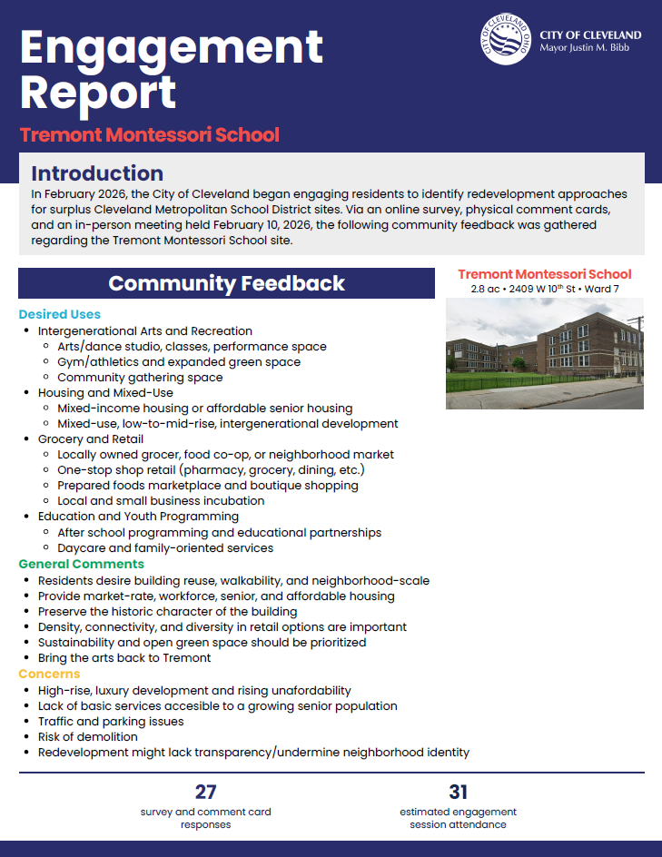
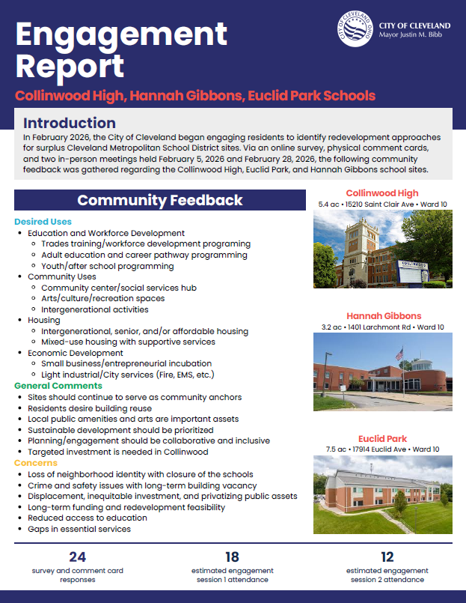
clevelandohio.gov

Slide 16
City Uses – Closed Sites
New City Fire Stations
Valley View
Brooklawn (New Tech West)
New Safety Facility
Miles
CMSD Board approval for transfer to the city is the start of our internal and external approval processes
clevelandohio.gov

Slide 17
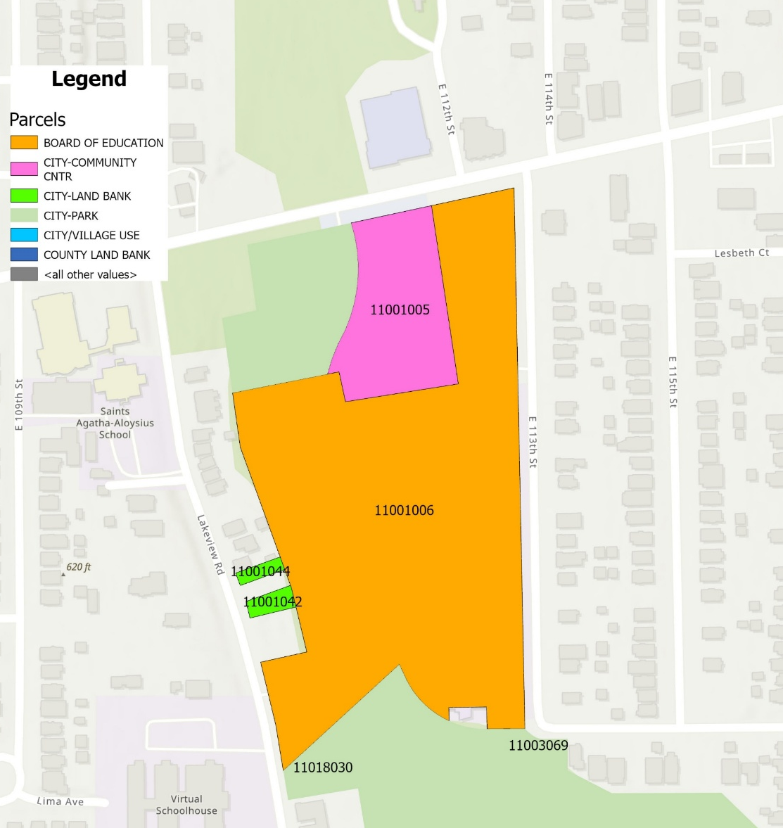
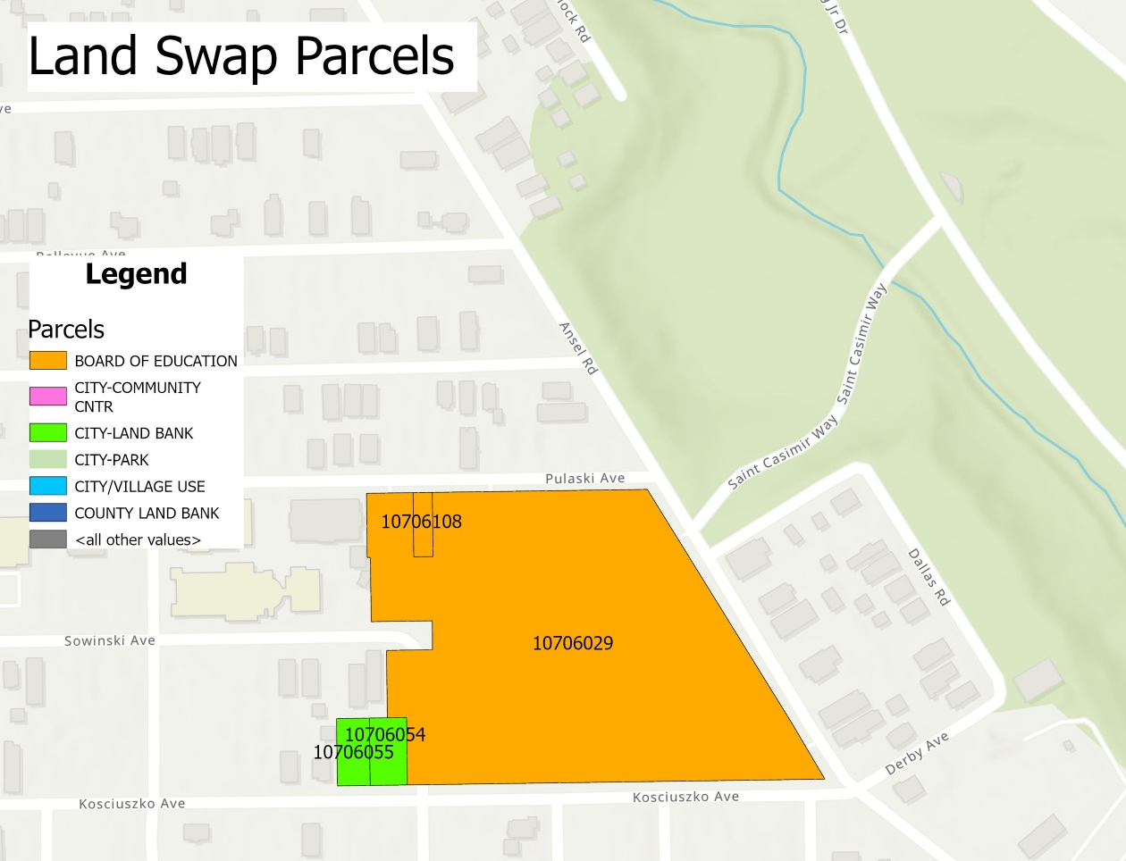
Next Steps – Facilitating Land Transfers
Glenville
Willson
clevelandohio.gov

Slide 18
Building Disposition
Karen Thompson

Slide 19
Planning for closing buildings incorporates many inputs
Building condition and status
Neighborhood needs and assets
CMSD needs
Legal parameters
Review of detailed building condition assessments
Landmark status and constraints
Must follow Ohio Revised Code in cases of building disposition
Have one year following close to take action
Opportunities to enrich educational programs for the remaining school properties
Administrative uses
Part of broader economic mobility strategy led by the City
Extensive opportunities for community members to provide input
Notes:
Could re-up visceral examples like “This will be the first year in a long time when we will not need to post someone 24/7 at some of our schools to tend to the boiler over the winter break”

Slide 20


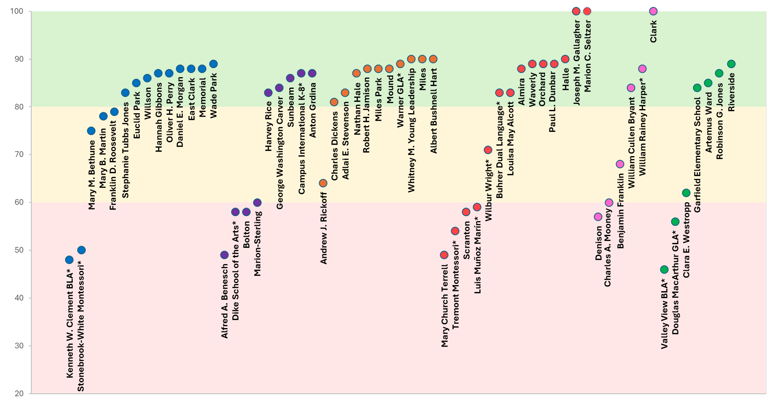
PreK-8 Building Condition
Our long-term goal is to keep every building at a condition score of 80 or higher.
Two thirds (66%) of our K-8 buildings are considered in “good” condition, with building condition scores of at least 80.
Northeast
East
Southeast
Near West
West
Southwest
The building condition score reflects maintenance needs for the main systems, like A/C, plumbing, roofs, and windows. Lower scores mean more repairs are needed. These scores are a snapshot in time as of Spring 2025, except for (1) Gallagher and Clark (scores of 100 for the new buildings that opened August 2025), and (2) Marion Seltzer (score of 100 for the building that is in design). Schools operated out of leased spaces not owned by CMSD are not included. *Specialty schools are shown with an asterisk.

Slide 21
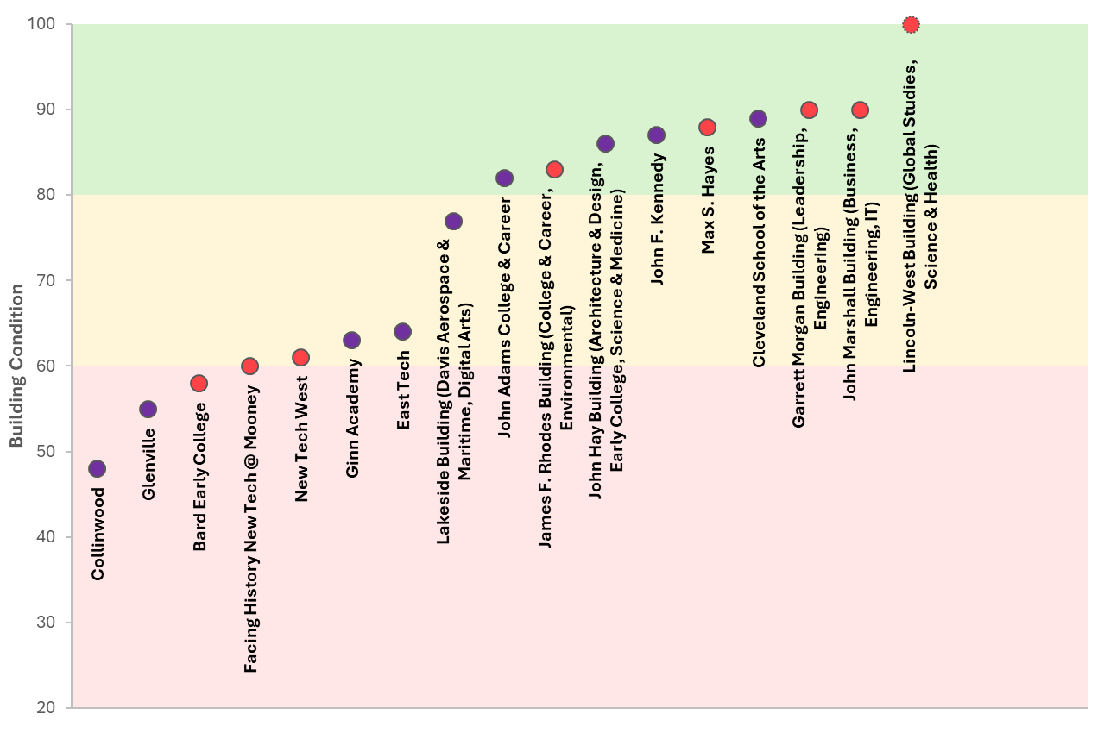
High School Building Condition
East side high schools
West side high schools
Our long-term goal is to keep every building at a condition score of 80 or higher.
Just over half (53%) of CMSD-owned high school buildings are considered in “good” condition, with scores of at least 80.
The building condition score reflects maintenance needs for the main systems, like A/C, plumbing, roofs, and windows. Lower scores mean more repairs are needed. These scores are a snapshot in time as of Spring 2025, except for Lincoln-West, which has a score of 100 for the new building that is in design. Only high schools in CMSD-owned buildings have building condition scores.

Slide 22
Legal parameters dictate the options we can explore
Properties could be organized into distinct categories for disposition:
School District Use: Properties retained for ongoing district purposes
Land Swap for New and Existing School Sites: Properties exchanged with the city in support of new school construction and enhancement of existing schools while providing city with community use
Sale-Leaseback: Buildings suitable for sale to other entities, while retaining some district use, as in previous arrangements like Magnet or Washington Park/First Tee
Public Offer: Properties offered directly to charters with less immediate district utility

Slide 23
School District Use
The District requires the use of district property that will become available in June 2026 for the following purposes:
Continued district functions, including possible use as a temporary swing site during construction projects
Additionally, these properties may be evaluated for sale-leaseback opportunities
This process is recommended for the following buildings:
Euclid Park (OFCC)
Mary B. Martin (OFCC)
Health Careers
Notes:
Response and report example attached

Slide 24
Land Swap/Exchange of Real Estate (ORC 3313.40)
This process is recommended for the following properties:
Alfred A. Benesch
Bolton
Brooklawn (New Tech West)
Dike
Kenneth Clement BLA
Mary Church Terrell
Michael R. White
Newton D. Baker
Tremont
Valley View BLA
Walton
Securing properties via land swap with the City will ensure that the district obtains parcels contiguous to or near existing school properties
Enhancements could include increased green space, learning gardens, playing fields, and additional parking, supporting and enriching educational programs for the remaining school properties
Swaps are mutually beneficial as they enable reuse for the public good
Notes:
Response and report example attached

Slide 25
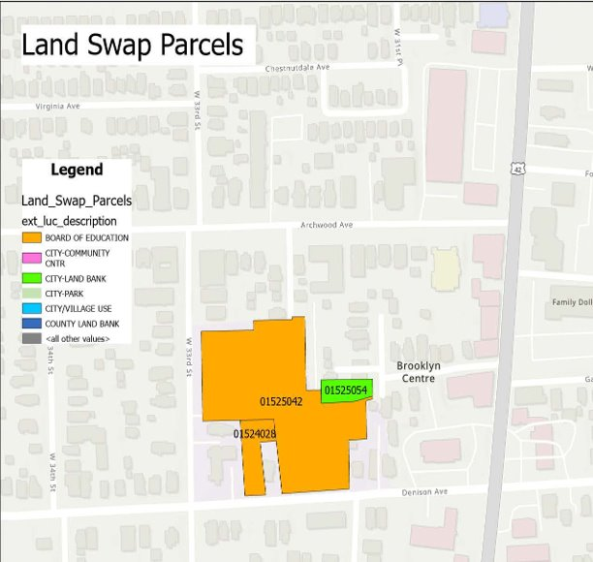
Land swaps provide an opportunity to meet CMSD, City and Community needs
Potential City Properties
FDR/Glenville Parcels (9)
Mary Bethune Parcels (6)
Willson Parcels (2)
East Clark/Memorial Parcels (3)
Denison Parcel (1)
Warner/Miles Park Parcels (5)
Marion-Sterling/Central Parcels (7)
Example: Denison parcel opportunity to expand parking or create a learning garden space​
25
Notes:
Response and report example attached

Slide 26
Sale and Leaseback Agreements (ORC 9.483)
Any new OFCC construction is well-suited for a sale-leaseback arrangement.
Regardless of other laws, a political subdivision may pursue this option
Aligns with the community needs identified during the City Engagement process
Key requirement is the asset must be a building; this option does not apply to land
The property may be sold to any purchaser, with the following conditions:
At closing, the purchaser must lease back a portion of the building to the district
The purchaser is required to undertake public improvements to all or part of the leased space
Example, Margaret Ireland – MAGNET includes School of One classroom spaces, along with middle-grade student field experiences utilizing the manufacturing space
Another example, Washington Park - First Tee, where district students benefit from the upgraded facility for golf and character-building programs
This process is recommended for the following properties:
Adlai Stevenson
Charles Dickens
Euclid Park
Hannah Gibbons
Louisa M. Alcott
Miles
Notes:
Response and report example attached

Slide 27
Public Offer (ORC 3313.41 and 3313.413)
Preparing for Public Offer:
The Board has decided the property is no longer needed for school use
An appraisal sets the fair market value and is submitted to the Board of Education with a resolution, usually taking 30 days
The District decides what items stay or are removed from the building
The auction follows with a 30-day notice, allowing site visits
An auctioneer may be hired (typically 10% of FMV) or the District can manage it
After auction, another 30-to-60-day period District handles title work and deed transfer, with costs usually paid by the buyer
The District issues notices about utility termination and related matters
This process is recommended for the following properties:
Charles Mooney
Collinwood
Notes:
Response/example report if needed
(contact: Emily Braman, C.P. Braman & Co., Inc.)
and report example attached

Slide 28
Building clean out will be more critical than ever
Building clean out is a typical part of end-of-year readiness, however, this year it will be especially important
Since Spring Break, dumpsters have been provided to certain closing buildings so they can proactively remove trash and unnecessary materials
Principals and custodians can request dumpsters as needed throughout the rest of the year; all impacted schools will have dumpster access at the end of the year
It is likely that items can/will be donated according to board policy. More information about this will be shared at an upcoming BOE meeting
Custodians will conduct the annual end-of-year walkthrough to capture areas needing repair, general maintenance, or painting

Slide 29
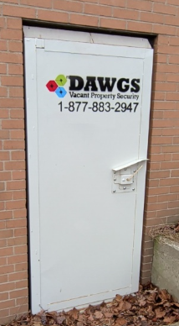
Securing closed buildings requires a collaborative approach
As buildings transition, keeping them secure, reducing risk and protecting district assets remain a top priority
In addition to standard security practices, CMSD collaborates with the Cleveland Police Department to enhance safeguards at closed buildings
Police officers walk closed CMSD properties during their shift
Cameras monitored by CPD have been placed at key locations
Cameras monitored by CMSD emphasized
The district also works with DAWGS for extra protection:
Enhanced security door on entrances/exits
Live monitoring across building with active alerts
Prompt on-site support when needed

Slide 30
The Board should expect a number of upcoming topics
Related Board action topics may include:
Land swaps
Sale leaseback
Auctions
Donation policy
Records retention policy

Slide 31
Segment 8/9 Progress to Date
Construction Projects Updates
Joseph Gallagher remodel completed - Spring 2025
Clark new build completed - August 2025
Marion Seltzer
New design completed – Summer 2025
Demolition completed – Fall 2025
New build begins – Spring 2026
Enhanced Space in partnership with Cudell Recreation Center
JFK football field in partnership with City of Cleveland - Summer 2026
In Design and Community Meetings
Lincoln-West High School design meetings in process - 2 completed to date
Abate and Demolish Eight Properties as Part of Segment 9 Work Cranwood ES Abate/Demo
Empire Computech ES Abate/Demo
Iowa-Maple ES Abate/Demo
Mt Auburn ES Abate/Demo
Paul Revere ES Abate/Demo
Audubon MS Abate/Demo
Central MS Abate/Demo
Willson MS Demo Robert P. Madison, International Inc. selected as A/E - Oct 2025 Hammond selected as the CMR- Feb 2026
Notes:
Construction- customer relation management

Slide 32
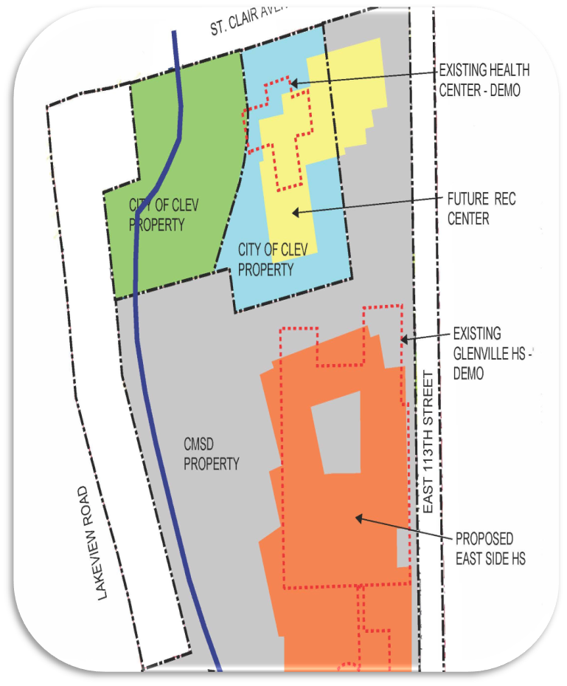
Segment 8/9 Progress to Date (cont.)
New Build Eastside HS - Glenville property
1200 students/supporting career pathways related to trades and health services
Auditorium/competition gymnasium
Solidifying the partnership with YMCA and City (MOU)
Finalized the site plan concept that may change or be adapted
TDA A/E selected for design phase/Oct 2025 and Hammond selected as CMR/Feb 2026
Next Steps Include
Resolution for BOE action to include:
Land swap parcels
Partnership agreement and timeline
Schedule community meetings
Beginning planning for swing site in 2027
Notes:
Construction- customer relation management

Slide 33
Building Readiness and Investments
Rachel Mikolajczyk

Slide 34
School moves represent a key summer milestone
Preparing for these moves has been a cross-functional effort
48 building walkthroughs have been completed with team members from Academics, Operations, Legal, etc.
Many departments are currently inventorying related items and discerning future use vs. item disposition options, including:
Facilities and Logistics: furniture and other equipment
IT: technology and infrastructure
School Nutrition: kitchen equipment
Academics: curriculum materials
Legal is generating guidance for school staff regarding record retention, etc.
Academics is generating guidance for school staff about item retention and disposal to ensure quality instruction materials are kept or moved as needed

Slide 35
School move timing is being heavily orchestrated
The team is planning on making the most of each available summer day
Five moving companies have been engaged to support the effort
Constraints exist around scheduling
Existing contractual terms regarding leased spaces
Some schools must move first to allow for other schools to move in
Older, larger buildings will require more time to clean out before formally shuttering
“Non-impacted” buildings experiencing classroom shifts due to incoming special populations must also be considered
Move schedule is divided into phases allowing more complicated moves to be initiated sooner

Slide 36
School staff is being supported along the way
A training video has been created to explain the process
FAQs and packing lists are being provided
In-person school visits are planned for highest need schools
Packing materials will be delivered to schools by May 1 to allow ample time for preparation
A labeling system will be used to ensure that boxes follow the staff
Notes:
FAQ document

Slide 37
Building investment projects have multiple origins
There are several different types of building investments that will be completed by CMSD Capital Projects or Trades.
Type | Definition | Example
Building Score to 80 | Building investments designed to bring the building assessment score up to 80+ based on MGT's BASYS framework | Roof and skylight upgrades at Franklin D. Roosevelt (future Stephanie Tubbs Jones) (Summer 26) Plumbing fixtures at Luis Muñoz Marin (Spring 26)
CTE Pathway | Building investments needed to implement new CTE pathways or programming | Cosmetology at John Adams High School (Fall 27) Welding at John F. Kennedy High School (Fall 27)
K8 Programming | Building investments needed to accommodate new K8 programming or additional encore offerings | Dance studio at Mound School of the Arts (Summer 26)
Preventative Maintenance | Building investments necessary to maintain building quality | Asphalt parking lot at Scranton and Denison (Summer 26) Chiller replacement at Stephanie Tubbs Jones (future Michael R. White Montessori) (Fall 26)
Special Population Update | Building investments needed to accommodate new student populations | Media center walls at Memorial (Summer 26)
Other | Building investments not listed in categories above (requested by admin, needed for operational functionality, facilitated by partners, etc.) | Walls & doors at Benjamin O. Davis, Jr. High School (Fall 26) Automated security gates and parking lot bollards at East Clark (Summer 26)
Notes:
John Adams High School - 3817 Martin Luther King Jr. Blvd.
Estimated Date to B&H - August 2026
Cosmetology Lab - converting two high bay classrooms into a cosmetology space with 26 chairs, four hair washing bowls, classroom, dispensary, storage, five nail stations, reception, waiting room and a restroom.
John F Kennedy High School - 15111 Miles Ave.
Estimated Date to Building & Housing & OpenGov - September 2026
Welding Lab - Converting two classrooms and two storage rooms into a Welding Lab to include 16 welding booths and storage.
John F Kennedy High School - 15111 Miles Ave.
Estimated Date to Building & Housing & OpenGov - April 2026
Art Room - Renovation
Ginn Academy - 655 East 162nd St.
Estimated Date to Building & Housing & OpenGov - August 2026
Precision Machinery - Converting office space, storage and a classroom into a lab with CNC machines, sheet metal brake, vertical knee mills, manual grinders, drill press, bank saw, engine lathes and CAD/CAM classroom.
Estimated Date to Building & Housing & OpenGov - April 2026
Exercise Science - Converting classrooms into a physical therapy training center with strength and conditioning equipment, and treatment tables with a classroom.
Estimated Date to Building & Housing & OpenGov - April 2026
A. D. Office Space - Converting classroom space into office and conference space.
Lakeside -1440 Lakeside Ave. Uploaded in OpenGov 4/9/2026
Estimated Date to Building & Housing & OpenGov - April 2026
Interior remodel to convert open classrooms into closed classrooms with drop ceilings, doors, and walls above ceiling.
Denison - 3799 West 33rd Street
Estimated Date to Building & Housing & OpenGov- April 2026
Interior kitchen renovation.
Various Schools
Estimated Date to OpenGov - June 2026 and September 2026
Casework replacement

Slide 38
While the most visible, the building improvement process includes more than just construction
Request for Proposal/ Getting a Quote
Design
Permitting
Bidding
Construction
~ 2 months
~ 2-12 months
~ 2 months
~ 2 months
Weeks/Months

Slide 39
Key Building Investment Accomplishments to Date
Multi-year plan to upgrade buildings in process
Conducted interviews of architecture and engineering firms; moving forward with Requests for Quotation from eight of them
Trades team has evaluated remaining buildings and defined scope of work to be done in-house
External improvements have commenced
New school building design and construction process continues
Preventative maintenance ongoing

Slide 40
BBF necessitates leveling up our annual processes, including school readiness
Cross-departmental governance being exercised
Formalized progress monitoring being established
KPIs and related metrics being proposed
Tracking and reporting mechanisms being generated
More effective and efficient annual readiness process

Slide 41
Q&A

Slide 42

Thank you.

